Slide 1

Advanced
Sequential
Files 1.

Slide 2
Single Record Type Files
In a file which contains only one record type (the kind we have examined so far) the record structure is described as part of the file FD using an 01 level number.
The record description creates a ‘buffer’ capable of storing one record instance at a time.
Each time a record is read from the file it overwrites the previous contents of the buffer.
The record buffer is the only connection between the file and the program.

Slide 3
Multiple Record Type Files
Quite often a single file will contain more than one type of record.
For instance, some of the terminal exercises required that your program apply a file of transaction records to the StudentsFile.
For simplicity, the Transaction file in these exercises contained one record type only; either Insertion or Update or Deletion.
In a real environment, transactions of this sort would normally be collected together into one single transaction file.

Slide 4
Implications of a multiple record transaction file.
Gathering all the transactions into a single file implies that the file will contain different record types (i.e. records with different structures).
The different record structures may give rise to records which are also of different lengths.
For example
  an insertion transaction will contain all the fields that appear in the StudentFile record (32 characters).
  a deletion transaction will contain only the StudentId (7 characters).
  an update transaction used to record course changes might contain the StudentId, the OldCourseCode and the NewCourseCode (15 characters).

Slide 5
Describing multiple record files
To describe these different record types we have to use more than one record description in the file's FD.
Because record descriptions always begin with level 01 we provide a 01 level for each record type in the file.

Slide 6
Multiple record descriptions - One record buffer
DATA DIVISION.
FILE SECTION.
FD TransactionFile.
01 InsertionRec.
02 StudentId PIC 9(7).
02 StudentName.
03 Surname PIC X(8).
03 Initials PIC XX.
02 DateOfBirth.
03 YOBirth PIC 9(2).
03 MOBirth PIC 9(2).
03 DOBirth PIC 9(2).
02 CourseCode PIC X(4).
02 Grant PIC 9(4).
02 Gender PIC X.
01 DeleteRec.
02 StudentId PIC 9(7).
01 UpdateRec.
02 StudentId PIC 9(7).
02 OldCourseCode PIC X(4).
02 NewCourseCode PIC X(4).
What is not obvious from this description is that COBOL continues to create just a single ‘record buffer’ for the file!
And this ‘record buffer’ is only able to store a single record at a time!

Slide 7
Multiple record descriptions in a file are IMPLICITLY redefinitions of the single record buffer.
TransactionFile Buffer
9 2 3 0 1 6 5 H E N N E S S Y R M 7 1 0 9 1 5 L M 5 1 0 5 5 0 F

Slide 8
Multiple record descriptions in a file are IMPLICITLY redefinitions of the single record buffer.
TransactionFile Buffer
InsertionRec
StudentId StudentName DateOfBirth CourseCode Grant Gender
9 2 3 0 1 6 5 H E N N E S S Y R M 7 1 0 9 1 5 L M 5 1 0 5 5 0 F

Slide 9
Multiple record descriptions in a file are IMPLICITLY redefinitions of the single record buffer.
TransactionFile Buffer
InsertionRec
StudentId StudentName DateOfBirth CourseCode Grant Gender
9 2 3 0 1 6 5 H E N N E S S Y R M 7 1 0 9 1 5 L M 5 1 0 5 5 0 F
StudentId
DeletionRec

Slide 10
Multiple record descriptions in a file are IMPLICITLY redefinitions of the single record buffer.
TransactionFile Buffer
InsertionRec
StudentId StudentName DateOfBirth CourseCode Grant Gender
9 2 3 0 1 6 5 H E N N E S S Y R M 7 1 0 9 1 5 L M 5 1 0 5 5 0 F
StudentId
DeletionRec
StudentId OldCourseCode NewCourseCode
UpdateRec

Slide 11
All these record descriptions are valid at the same time.
But only one description makes sense for the values in the buffer.
How can we tell which description to use?
TransactionFile Buffer
InsertionRec
StudentId StudentName DateOfBirth CourseCode Grant Gender
9 2 3 0 1 6 5 H E N N E S S Y R M 7 1 0 9 1 5 L M 5 1 0 5 5 0 F
StudentId
DeletionRec
StudentId OldCourseCode NewCourseCode
UpdateRec

Slide 12
The Transaction Type Code
Generally we cannot reliably establish the type of record READ into the buffer by examining its contents.
To allow us to distinguish between the record types, a special data item is inserted into each transaction which identifies the transaction type.
This data item is usually the first data item in the transaction record and one character in size, but it does not have to be.
Transaction types can be identified using a number, a letter or other character.

Slide 13
The Revised FD.
DATA DIVISION.
FILE SECTION.
FD TransactionFile.
01 InsertionRec.
02 TransCode PIC X.
02 StudentId PIC 9(7).
02 StudentName.
03 Surname PIC X(8).
03 Initials PIC XX.
02 DateOfBirth.
03 YOBirth PIC 9(2).
03 MOBirth PIC 9(2).
03 DOBirth PIC 9(2).
02 CourseCode PIC X(4).
02 Grant PIC 9(4).
02 Gender PIC X.
01 DeleteRec.
02 TransCode PIC X.
02 StudentId PIC 9(7).
01 UpdateRec.
02 TransCode PIC X.
02 StudentId PIC 9(7).
02 OldCourseCode PIC X(4).
02 NewCourseCode PIC X(4).
TransCode occurs in all the record descriptions.
How can we refer to the one in DeleteRec?
MOVE TransCode OF DeleteRec TO TCode.
But TransCode really only needs to be defined in one record.
Since all the records map on to the same area of storage the TransCode defined for the InsertionRec can be used no matter which record type is actually in the buffer .

Slide 14
The Final FD.
DATA DIVISION.
FILE SECTION.
FD TransactionFile.
01 InsertionRec.
88 EndOfTransFile VALUE HIGH-VALUES.
02 TransCode PIC X.
88 Insertion VALUE "I".
88 Deletion VALUE "D".
88 Update VALUE "U".
02 StudentId PIC 9(7).
02 StudentName.
03 Surname PIC X(8).
03 Initials PIC XX.
02 DateOfBirth.
03 YOBirth PIC 9(2).
03 MOBirth PIC 9(2).
03 DOBirth PIC 9(2).
02 CourseCode PIC X(4).
02 Grant PIC 9(4).
02 Gender PIC X.
01 DeleteRec.
02 FILLER PIC X(8).
01 UpdateRec.
02 FILLER PIC X(8).
02 OldCourseCode PIC X(4).
02 NewCourseCode PIC X(4).
TransCode and StudentId have the same description and are in the same location in all three records.
So they are defined only in the InsertionRec.
In the other records the area occupied by these two items is defined using FILLER.

Slide 15
What happens when we display the OldCourseCode?
What happens if we now read an Update record into the buffer?
TransactionFile Buffer
InsertionRec
TransCode StudentId StudentName DateOfBirth CourseCode Grant Gender
I 9 2 3 0 1 6 5 H E N N E S S Y R M 7 1 0 9 1 5 L M 5 1 0 5 5 0 F
FILLER
DeletionRec
FILLER OldCourseCode NewCourseCode
UpdateRec

Slide 16
When a record smaller than the size of the largest record is read into the buffer any data that is not explicitly overwritten is left intact.
What happens when we display StudentName and DateOfBirth?
TransactionFile Buffer
InsertionRec
TransCode StudentId StudentName DateOfBirth CourseCode Grant Gender
U 9 3 1 5 6 8 2 L M 6 1 L M 5 1 R M 7 1 0 9 1 5 L M 5 1 0 5 5 0 F
FILLER
DeletionRec
FILLER OldCourseCode NewCourseCode
UpdateRec

Slide 17
Printing a Report.
A program is required which will print a report.
The report, called the Student Details Report, will be based on the file Students.Dat.
The report will show the Name, StudentId, Gender and CourseCode of each student in the file.
A report is made up of groups of printed lines of different types.
What types of line are required for the Student Details Report?

Slide 18
Report Print Lines.
Page Heading.
  UL Student Details Report
Page Footing.
  Page : PageNum
Column Headings.
  Student Id. Student Name Gender Course
Student Detail Line.
  StudentId. StudentName Gender CourseCode
Report Footing.
  *** End of Student Details Report ***

Slide 19
Describing Print Lines.
01 PageHeading.
02 FILLER PIC X(7) VALUE SPACES.
02 FILLER PIC X(25)
VALUE "UL Student Details Report".
01 PageFooting.
02 FILLER PIC X(19) VALUE SPACES.
02 FILLER PIC X(7) VALUE "Page : ".
02 FILLER PIC 99.
01 ColumnHeadings PIC X(36)
VALUE " StudentId StudentName Gender Course".
01 StudentDetailLine.
02 PrnStudId PIC BB9(7).
02 PrnStudName PIC BBX(10).
02 PrnGender PIC BBBBX.
02 PrnCourse PIC BBBBX(4).
01 ReportFooting PIC X(38)
VALUE "*** End of Student Details Report ***".
The Print Lines are all different record types!

Slide 20
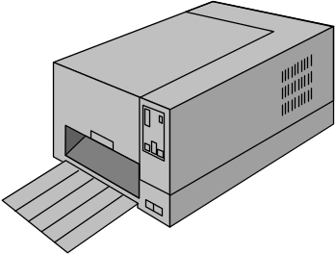
The File Buffer
All data coming from, or going to, the peripherals must pass through a file buffer declared in the File Section.
The file buffer is associated
with the physical device by
means of a Select and
Assign clause.
In previous
lectures we saw
that the file buffer
is represented by a record description (01 level).
But the different types of line that must appear on our report are declared as different record types.
How can we declare these different record types in the File Section?
ENVIRONMENT DIVISION.
INPUT-OUTPUT SECTION.
FILE-CONTROL.
SELECT Printer
ASSIGN TO “LPT1”.
DATA DIVISION.
FILE SECTION.
FD Printer.
01 PrintLine.
????????????????

Slide 21
No VALUE clause in the FILE SECTION.
Defining a file buffer which is used by different record types is easy (as we have seen).
But !!
These record types all map on to the same area of storage and print line records cannot share the same area of storage.
Why? Because most of the print line record values are assigned using the VALUE clause and these values are assigned as soon as the program starts.
To prevent us trying to use the VALUE clause to assign values to a File buffer COBOL has a rule which states that;
In the FILE SECTION, the VALUE clause must be used in condition-name entries only (i.e. it cannot be used to give an initial value to an item).

Slide 22
A Solution
We get round the problem as follows;
We define the print records in the WORKING-STORAGE SECTION.
We create a file buffer in the FILE SECTION which is the size of the largest print record.
We print a line by moving the appropriate print record to the file buffer and then WRITEing the contents of the file buffer to the device.

Slide 23
ENVIRONMENT DIVISION.
INPUT-OUTPUT SECTION.
FILE-CONTROL.
SELECT ReportFile ASSIGN TO “STUDENTS.RPT”.
DATA DIVISION.
FILE SECTION.
FD ReportFile.
01 PrintLine PIC X(38).
WORKING-STORAGE SECTION.
01 PageHeading.
02 FILLER PIC X(7) VALUE SPACES.
02 FILLER PIC X(25)
VALUE "UL Student Details Report".
01 PageFooting.
02 FILLER PIC X(19) VALUE SPACES.
02 FILLER PIC X(7) VALUE "Page : ".
02 FILLER PIC 99.
01 ColumnHeadings PIC X(36)
VALUE " StudentId StudentName Gender Course".
01 StudentDetailLine.
02 PrnStudId PIC BB9(7).
02 PrnStudName PIC BBX(10).
02 PrnGender PIC BBBBX.
02 PrnCourse PIC BBBBX(4).
01 ReportFooting PIC X(38)
VALUE "*** End of Student Details Report ***".
DISK
STUDENTS.RPT

Slide 24
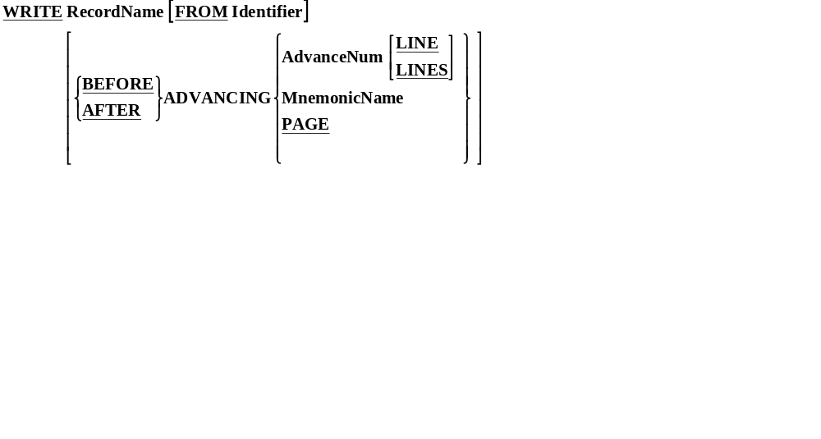
WRITE Syntax revisited.
When we are writing to a printer or a print file we use a form of the WRITE command different from that we use when writing to a sequential file.

Slide 25
ENVIRONMENT DIVISION.
INPUT-OUTPUT SECTION.
FILE-CONTROL.
SELECT ReportFile ASSIGN TO "STUDENTS.RPT"
ORGANIZATION IS LINE SEQUENTIAL.
DATA DIVISION.
FILE SECTION.
FD ReportFile.
01 PrintLine PIC X(40).
WORKING-STORAGE SECTION.
01 HeadingLine PIC X(21) VALUE " Record Count Report".
01 StudentTotalLine.
02 FILLER PIC X(17) VALUE "Total Students = ".
02 PrnStudentCount PIC Z,ZZ9.
01 MaleTotalLine.
02 FILLER PIC X(17) VALUE "Total Males = ".
02 PrnMaleCount PIC Z,ZZ9.
01 FemaleTotalLine.
02 FILLER PIC X(17) VALUE "Total Females = ".
02 PrnFemaleCount PIC Z,ZZ9.
DISK
STUDENTS.RPT
MOVE StudentCount TO PrnStudentCount
MOVE MaleCount TO PrnMaleCount
MOVE FemaleCount TO PrnFemaleCount
WRITE PrintLine FROM HeadingLine AFTER ADVANCING PAGE
WRITE PrintLine FROM StudentTotalLine AFTER ADVANCING 2 LINES
WRITE PrintLine FROM MaleTotalLine AFTER ADVANCING 2 LINES
WRITE PrintLine FROM FemaleTotalLine AFTER ADVANCING 2 LINES.

